Slide 1
Missed Meals Tracker
SRA Matthew Enderle

Slide 2
Overview
How to acquire
Initial Setup
Adding Tracked Members
Marking Missed Meals
Printing forms

Slide 3
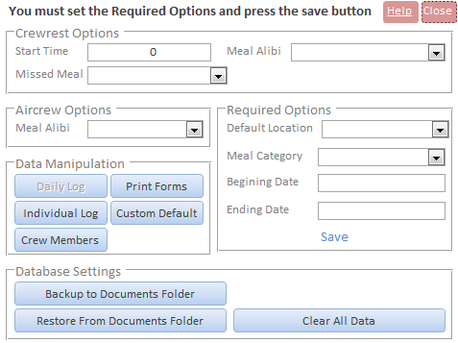
Initial Setup
Required options must be filled in order to input missed meals.
Dates can be changed any time.
Title bar will display what needs to be done in order for it to work.

Slide 4
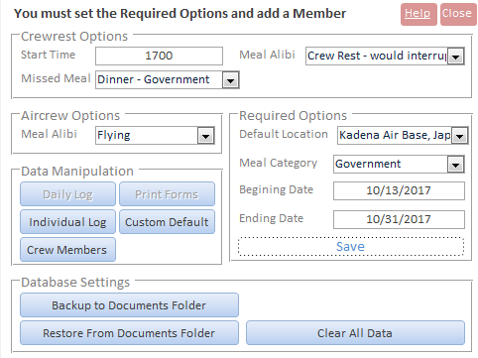
Main Form Information
Crew rest Options
Start time: set to the normal start time for crew rest
Meal Alibi: this is what DTS/Finance will use to verify missed meal for crew rest
Missed Meal: this will set default crew rest to start at this time. Most likely Government.
Aircrew Option
Meal Alibi: same as crew rest but used for flights
Required Options
Default Location: set to where you are TDY
Meal Category: Usually Government
Beginning Date: This is when you leave home
Ending Date: set to last date on orders. You can change it later.

Slide 5
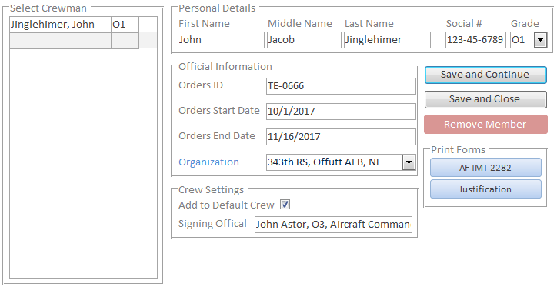
Member Management
Social is not recommended to be entered until ready to print the form. You can use a temporary one like 123-45-6789.
Official Information
Orders ID: set to what is on your orders
Orders Start/End Date: set it to the dates on the orders
Organization: Select appropriate org. If it is not listed add it by clicking on the blue organization text
Crew Settings
Add to default crew: adds member to flights automatically
Signing Official: This will be printed on the form for the local signing officer

Slide 6
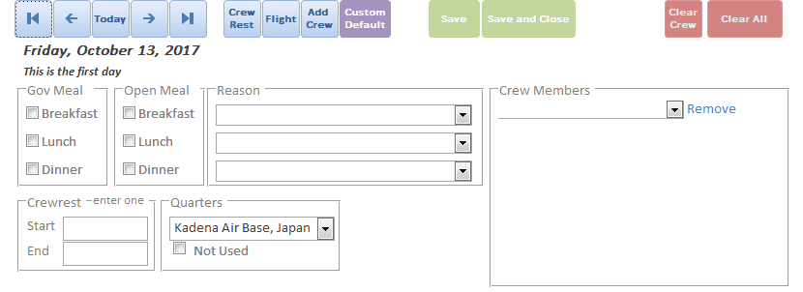
Marking Missed Meals As a Group
Crew rest and flight buttons will set the selected date to that event. They will also add the members marked as default.
Add crew only adds all the default crew.
Useful for if your crew goes misses a meal due to SPINS testing, etc.
Don’t forget to select a meal and a reason.
Crew rest
The other time will be calculated.
You only need to enter the start or the end.

Slide 7
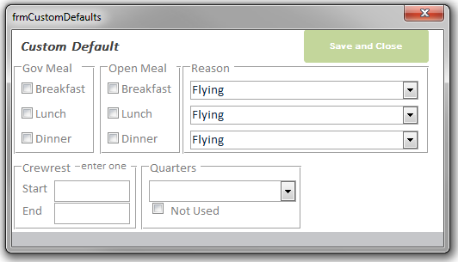
Marking Missed Meals As a Group
Custom Defaults will set the date to the specified settings from the main form’s button for custom defaults.
This is useful if one member does a staff job but is on your orders and wants to be tracked as well.

Slide 8
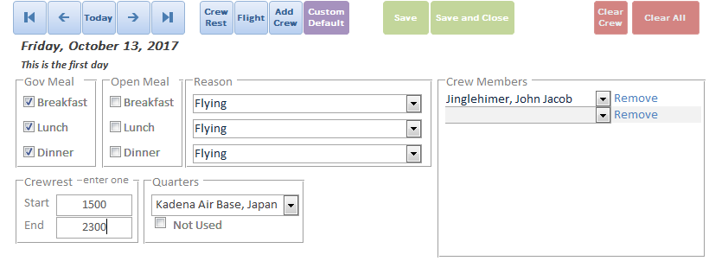
Marking Missed Meals As a Group
This is an example of a flight with the default crew.

Slide 9
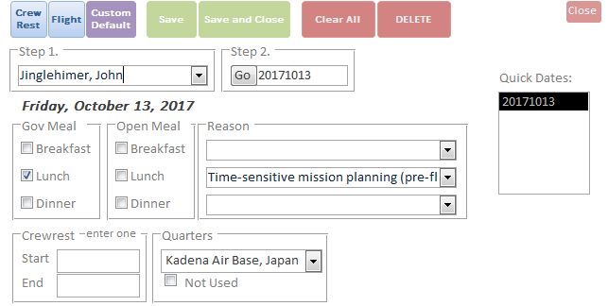
Marking Missed Meals As an Individual
This is an example of an individual that was mission planning. The rest of the crew didn’t mission plan so it is an individual log.

Slide 10
Printing Forms
Accessed via the Member Management form
AF IMT 2282 is what IPR needs to sign
Justification is what DTS needs

Slide 11
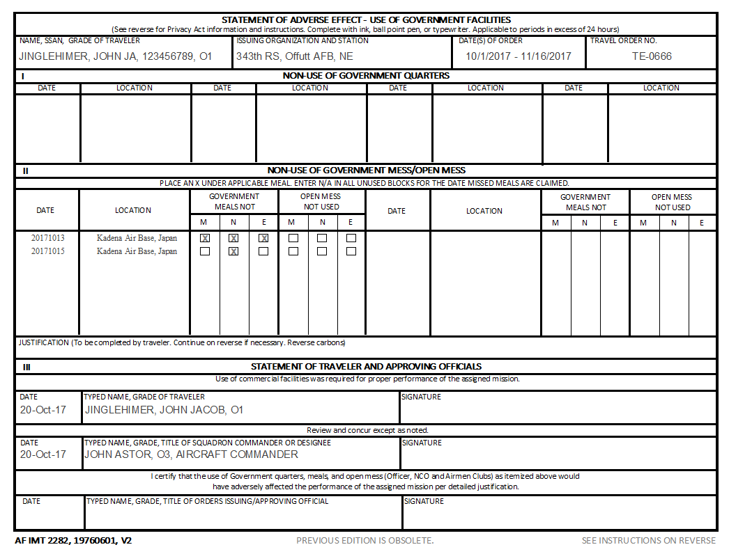
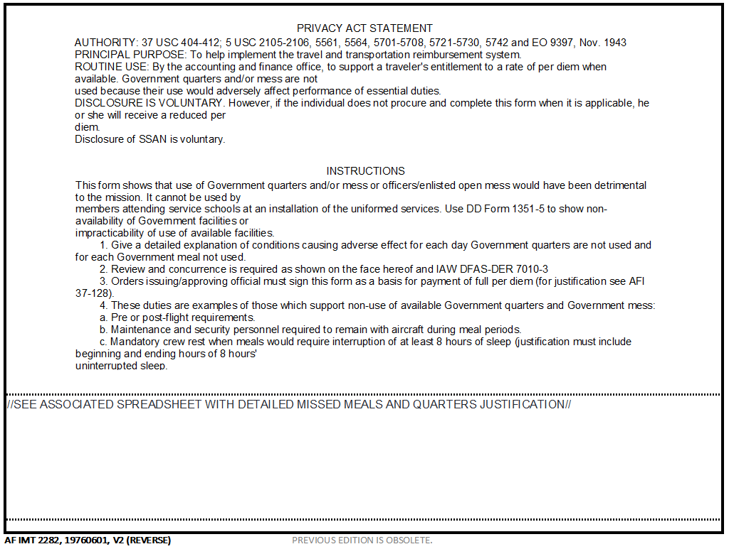
Printing Forms (Cont.)
Press CTRL + P to print the form.
Recommended to print duplex so the instructions are on the back.

Slide 12
Summary
How to acquire
Initial Setup
Adding Tracked Members
Marking Missed Meals
Printing forms

